Slide 1
Introduction to C
By 108316101 林濟棟
108316135 林廣濤

Slide 2
CONTENT
1
Introduction of C program format
2
Obtain data from user
3
Variable and Data Types
4
Arithmetic calculations

Slide 3
1
Introduction of C program format

Slide 4
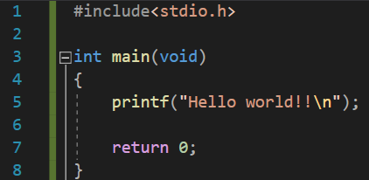
Introduction of C program format
4
C programs contain one or more functions but only one main function.
Every program in C begins executing at the function main
Framework of a Program
基礎框架
Statements (敘述)
-Instruct the program to perform an action
-All statements end with a semicolon (;)
The main function is where a C/C++ program starts to execute.
A left brace, {, begins the body of every function. A corresponding right brace,}, ends each function
In parentheses () are arguments. void means no argument

Slide 5
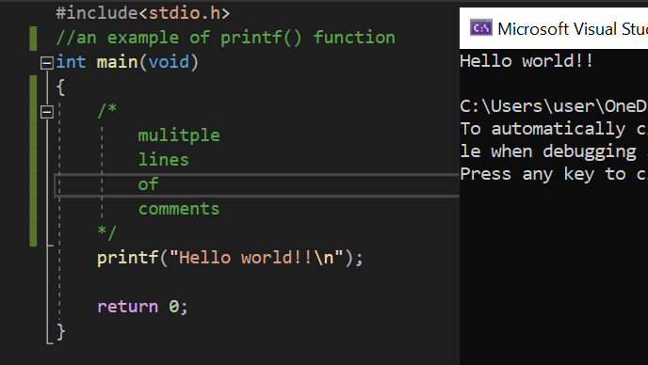
Introduction of C program format
printf() Function
Instructs computer to show something in output terminal
Prints the string of characters within quotes (" ")
Is a statement , must end with a semicolon(;)
Comment 注解
Text surrounded by /* and */ or start with // are comments, which is ignored by computer.

Slide 6
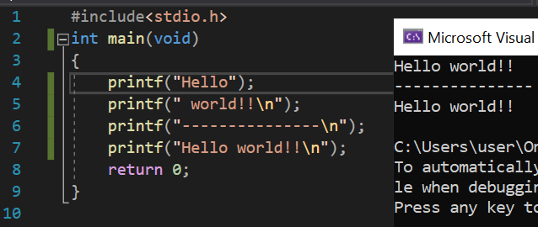
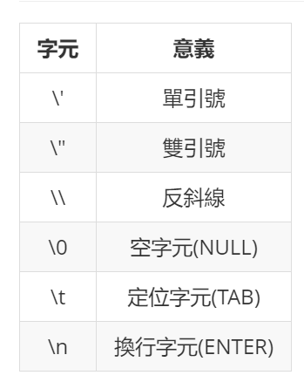
Introduction of C program format
Output the same results
Escape Sequence 跳脫字元
當編譯器在字串常數中讀到反斜線字元「\」會自動抓取 下一個字元使其形成跳脫字元（escape character）。

Slide 7
Introduction of C program format
#Include
Lines beginning with # are processed by the preprocessor before compilation.
編譯預處理命令都以“#”开頭，是在程序編譯之前要處理的内容
#include <stdio.h>
include the contents of the standard input/output header () in the program.
在程序中用到系統提供的標準函数庫中的輸入輸出函数時，應在程序的开頭写上一行#include<stdio.h> ,這樣才能調用此函数。
printf() function 包含在此函數庫中。

Slide 8
2
Obtain data from user

Slide 9
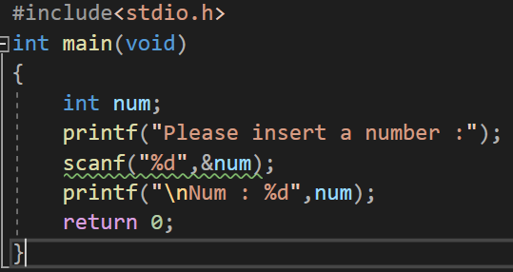

Obtain data from user
scanf("%d",&num);
The user responds to the scanf() statement by typing in a number, then pressing the enter key
Obtaining data from standard input (keyboard)
Given two arguments (需要給予兩個參數)
“%d” – indicates input string should be a decimal integer. (表示輸入為整數的形態)
&num – memory address of num, the variable to store. (為變數 num 的記憶體位址)
& – address operator (取址運算子)
num
2
Result :
Address : 2004
&num : 2004

Slide 10

Obtain data from user
Exercise 隨堂練習
寫一個C程式，在螢幕上印出姓名且在輸入自己的身高和體重後，在姓名下印出所輸入的身高體重
輸出範例:

Slide 11
3
Variable and Data Types

Slide 12
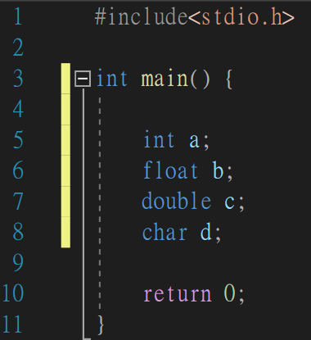
Variable and Data Types
int整數,佔 4 Bytes
Float浮點數,佔4Bytes
(有效位數 6 位)
double倍精確度浮點數，佔 8 Bytes (有效位數 15 位)
char 字元，佔 1 Byte

Slide 13
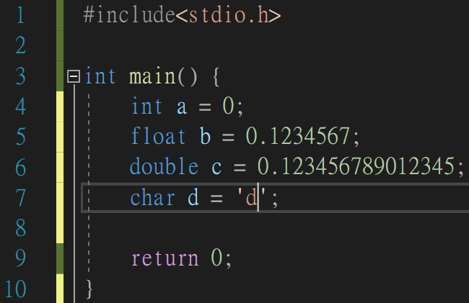
Variable and Data Types
資料初始化
"="在C語言中是"指派"的意義

Slide 14
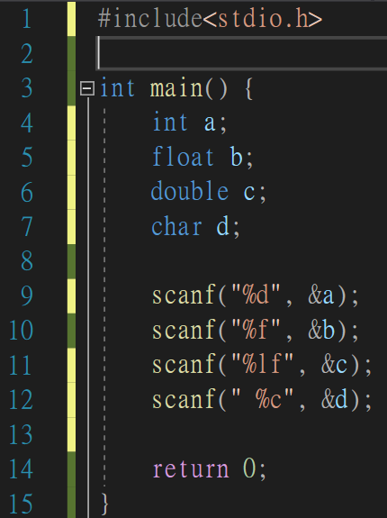
Variable and Data Types
int->%d
float->%f
double->%lf
char->%c
string->%s(以後會提到)

Slide 15
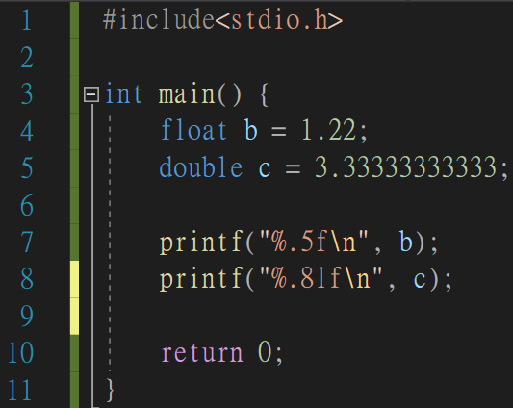
Variable and Data Types
指定輸出小數後幾位的方法

Slide 16
4
Arithmetic calculations

Slide 17
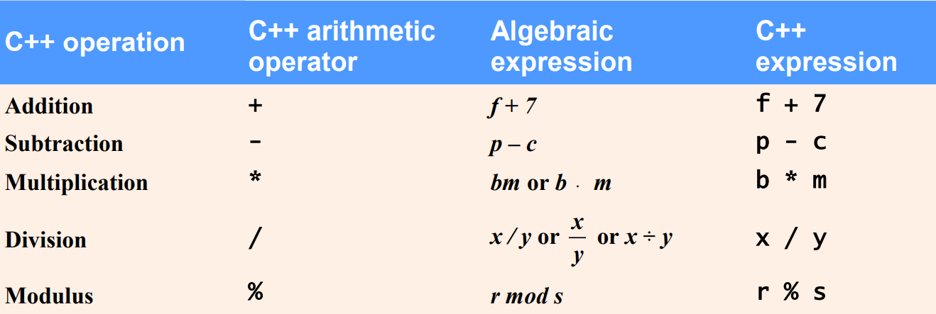
Arithmetic calculations

Slide 18
Arithmetic calculations
i++
i + 1
++i
i+=1
i=i+1

Slide 19
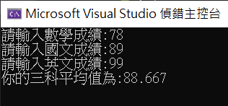
Homework
計算平均:
輸出範例
(1)依序輸入三個成績
請輸入你的數學成績: 78
請輸入你的國文成績: 89
請輸入你的英文成績: 99
(2)輸出平均
你的三科平均值為: 88.667
(平均值的資料型態使用float且輸出小數點後三位就好)

Slide 20
谢谢您的观看
THANKS FOR YOUR WATCHING
谢谢聆听

